Slide 1


TERM PROJECT
Provincial Reservoir Distribution Analysis
曾熙 12212754
2024.12.25

Slide 2
CONTENTS
01
INTRODUCTION
02
METHODOLOGY
Data Preprocessing
Correlation Hypothesis
Buffer Creation
Zonal Statistics
Data Visualization
03
ANALYSIS
Provincial Reservoir Count & Volume
GDP & Population Correlation
NDVI Spatial Distribution

Slide 3
01
Introduction
Data Interpretation and Correlation Hypothesis

Slide 4
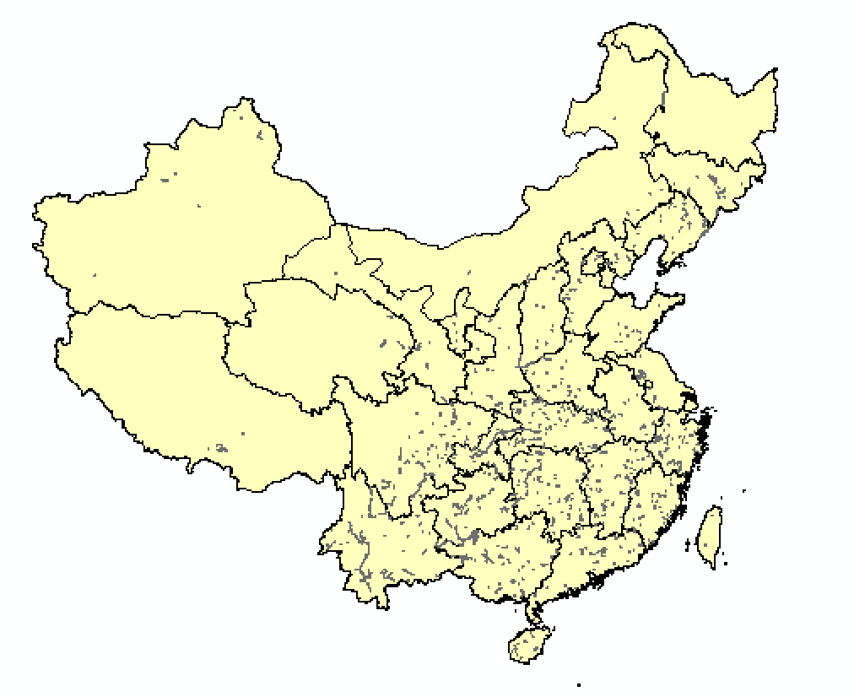
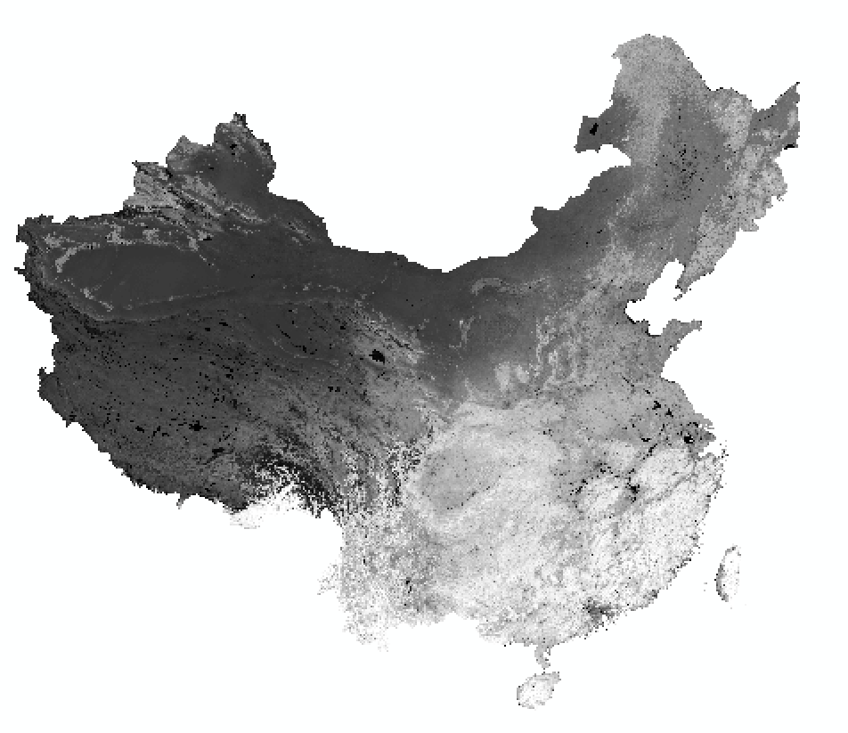
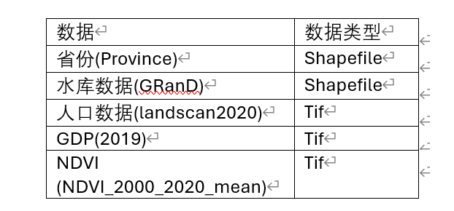
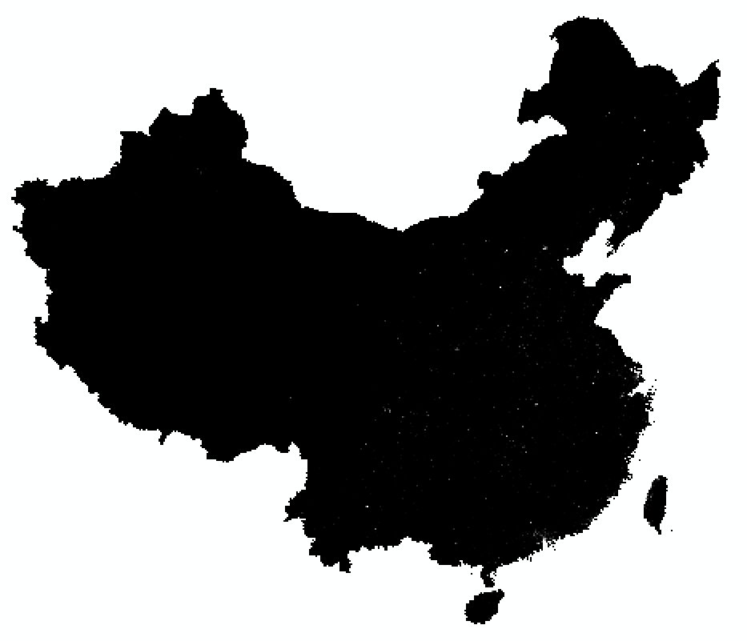
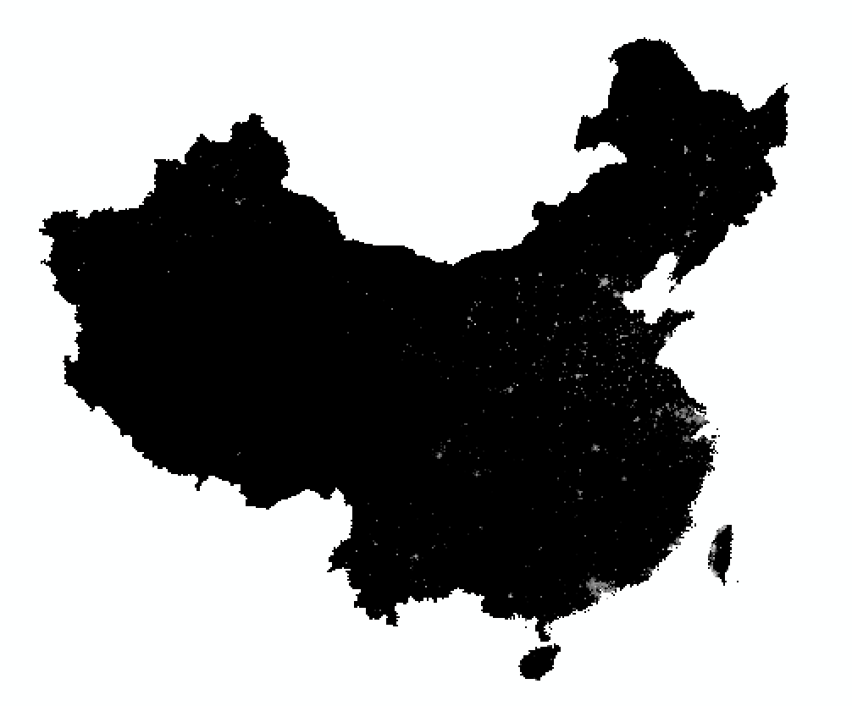
01
Data Interpretation
NDVI_chn
landscan-global-2020-China
2019GDP_China

Slide 5
01
Correlation Hypothesis
Reservoir Spatial Distributaion
Population
NDVI
GDP
What’s the spatial distribution of the number and capacity of reservoirs in each province?
What are the population and GDP characteristics 20km around each reservoir?
What are the characteristics of mean NDVI distribution10, 20, and 50km around separately?

Slide 6
02
Methodology
List of Toolkits including ArcGIS Tools and Python Packages

Slide 7



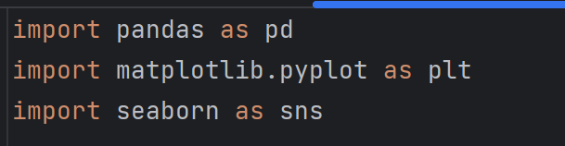
02
Toolkit
Map Creation
Statistics
Spatial Analysis
Data Visualization

Slide 8
03
Results Analysis
Spatial Distribution if each Buffer Area

Slide 9
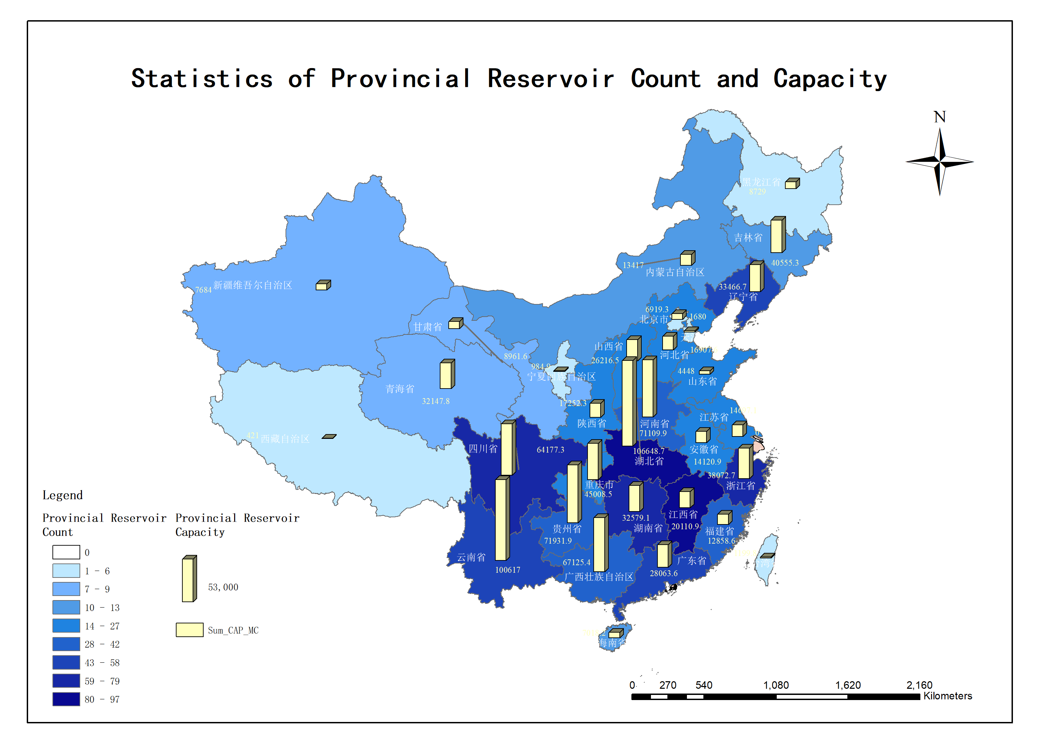
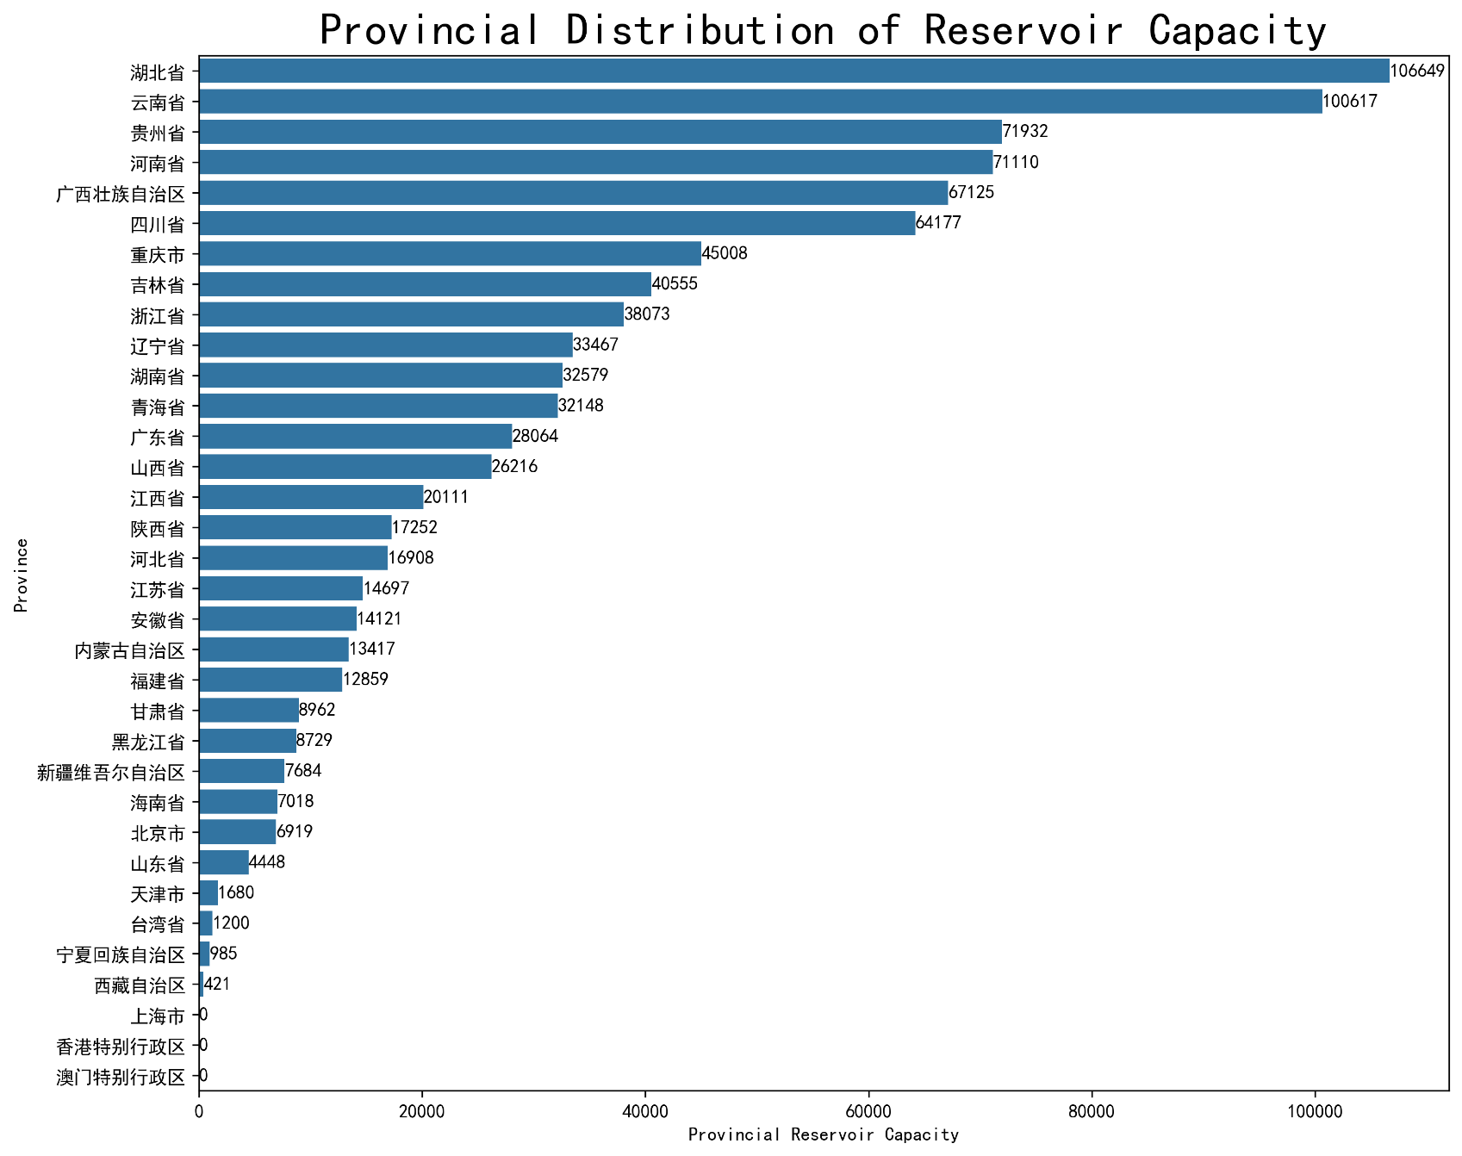
03
Reservoir Count and Capacity Statistics
总体特点：
南多北少，东多西少
各省资源分布不均
Max：湖北，云南，贵州
Min：天津，台湾，宁夏，西藏

Slide 10
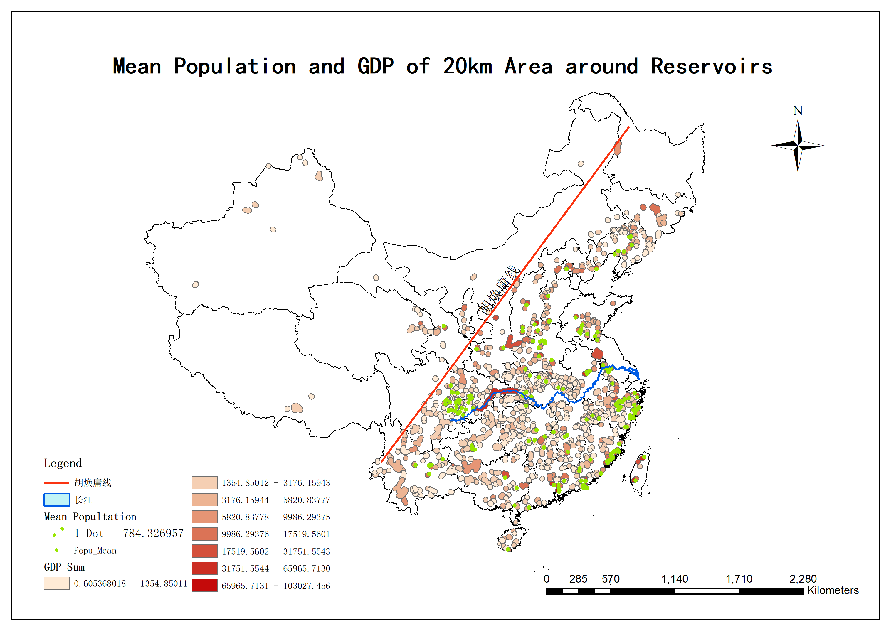
03
20km Buffer Population and GDP Statistics
总体特点：
水库主要分布在我国东南季风区
96.2%位于胡焕庸线以东南地区
人口密集区与GDP高值区高重合率
长江中上游地区
东南沿海

Slide 11
03
20km Buffer Population and GDP Statistics
总体特点：
水库主要分布在我国东南季风区
96.2%位于胡焕庸线以东南地区
人口密集区与GDP高值区高重合率
长江中上游地区
东南沿海

Slide 12
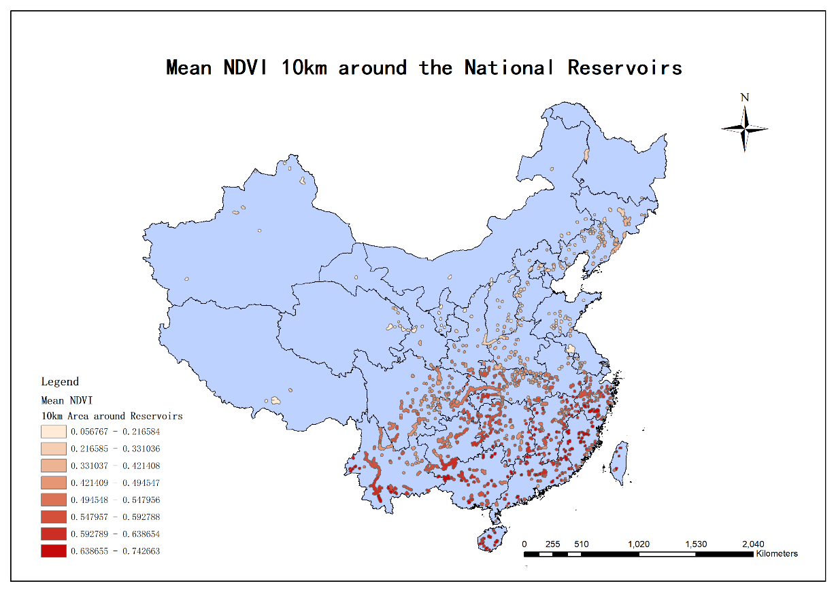
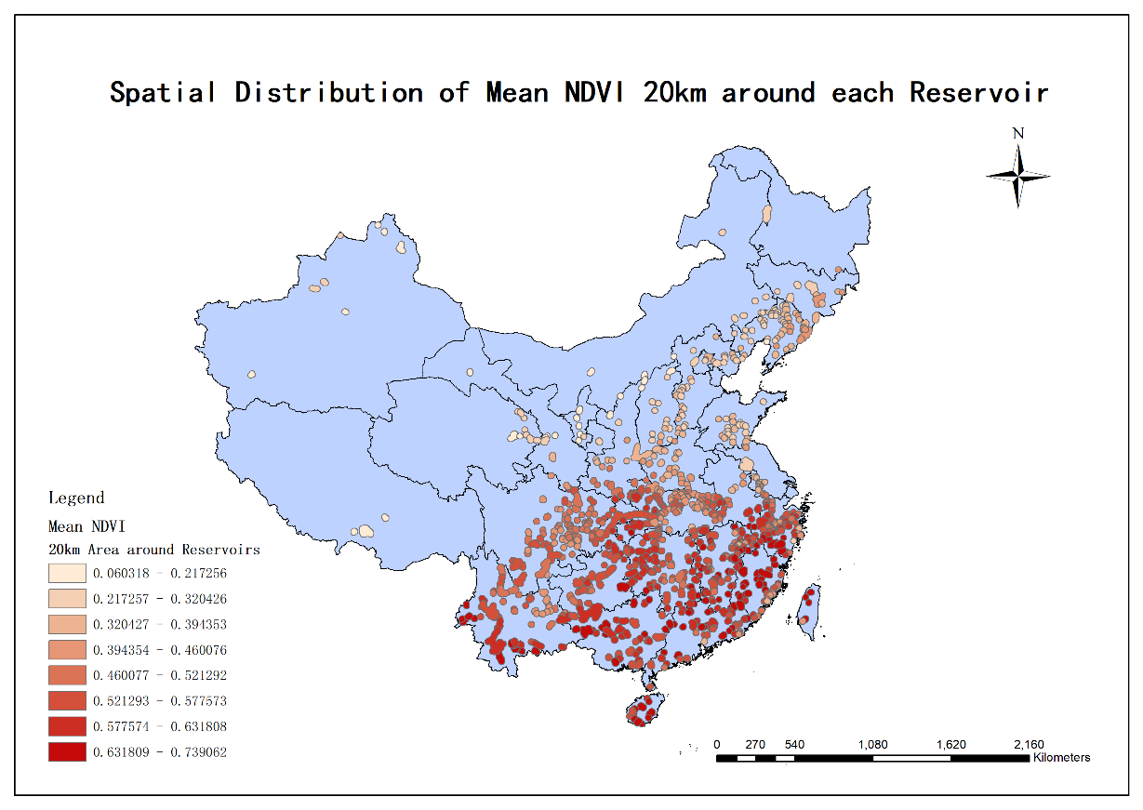
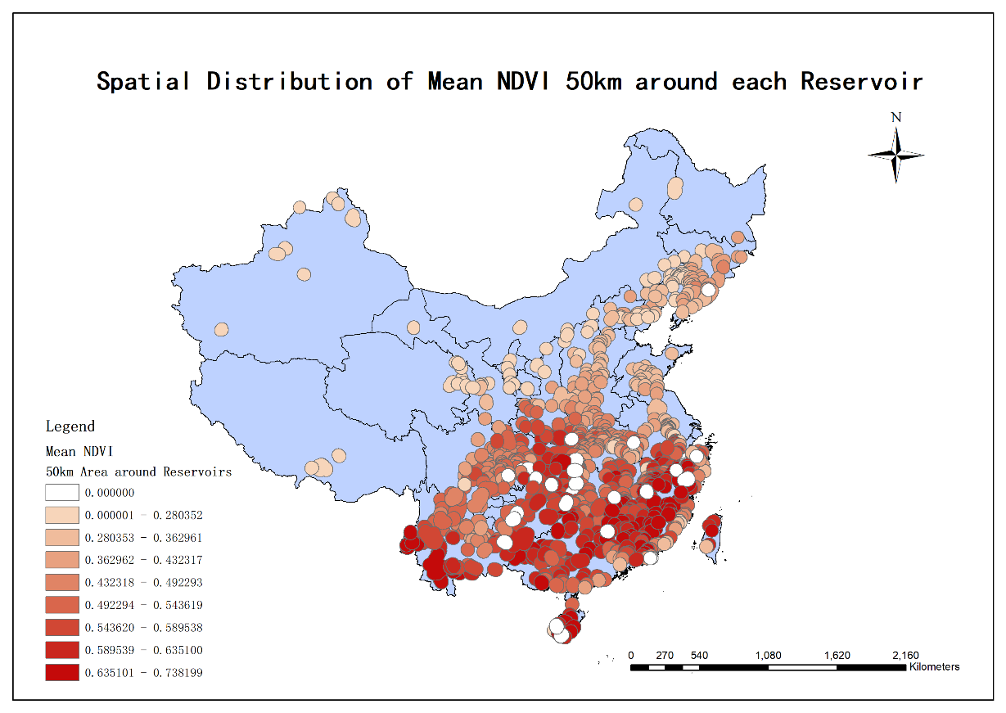
03
Mean NDVI Analysis
10km Buffer
20km Buffer
50km Buffer

Slide 13
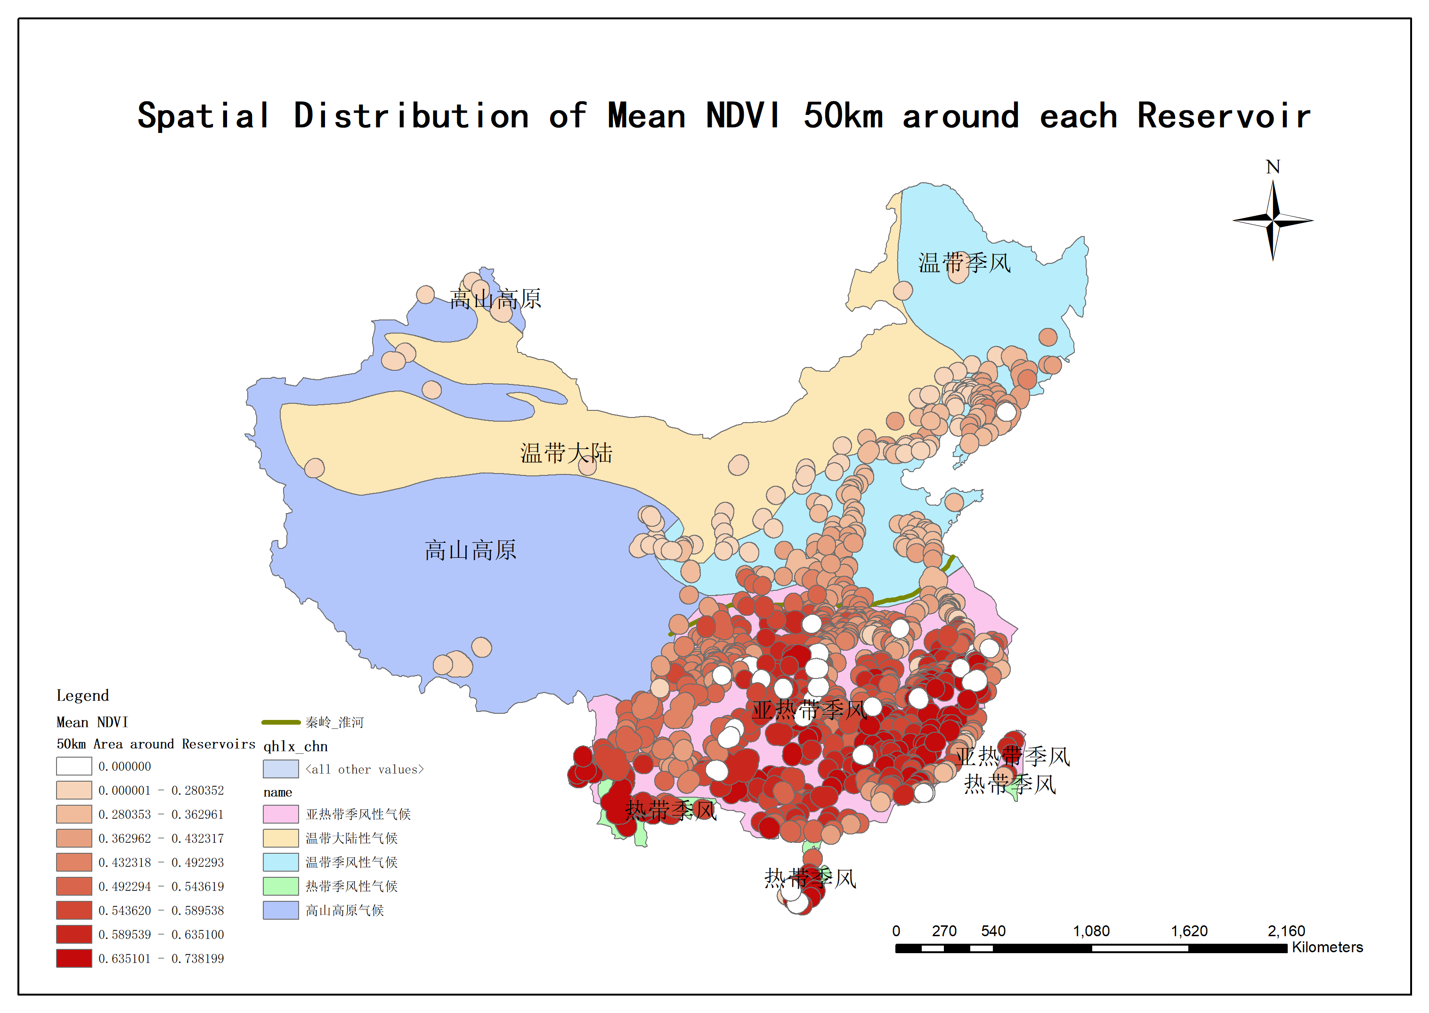
03
Mean NDVI Analysis (50km Buffer)
水库周边NDVI高值区（Mean>0.5）
集中分布在热带与亚热带季风区
秦岭-淮河线以南
热带雨林 & 亚热带常绿阔叶林集中分布；
水资源丰富，植被多样性好，覆盖率高；
全年植被覆盖时间长

Slide 14

Q&A

Slide 15
Thanks for Listening!
2024.12.25

